Slide 1
Human Growth and Social Environment
Lecture 3 – Developmental stage (From pregnancy to infancy)

Slide 2
http://www.youtube.com/watch?v=Ia4HE5NSXEw&feature=related
孕婦懷孕十大禁忌
http://www.youtube.com/watch?v=8H7Gas4W2Ls
Prenatal smoking found increases risk of childhood psychiatric problem

Slide 3
Nature and Nurture: influences of heredity and environment
How heredity and environment work together
Some characteristics influenced by heredity and environment
Prenatal development monitoring and promoting prenatal development

Slide 4
How heredity and environment work together
Reaction range
Refers to a range of potential expressions of a hereditary (遺傳) trait (特質). Body size, for example, depends largely on biological processes, which are genetically regulated.
Even so, a range of sizes possible, depending on environmental opportunities and constraints and a person’s behavior.

Slide 5
Normal babies follow a typical sequence of motor development: crawling, walking, and running, in that order, at certain approximate ages. However, even motor development can be influenced by environmental experiences such as cultural child-rearing practices that affect its pace and timing.

Slide 6
Genotype (基因)-environment interaction
Refers the effects of similar environmental conditions on genetically different individuals.
Because genes influence a person’s exposure to particular environments
the environment often reinforces genetic difference.

Slide 7
Some characteristics influenced by heredity and environment
Physical and physiological traits (特徵)
Not only do monozygotic twins generally look alike, but they also are more concordant (一致) than dizygotic twins in their risk for such as medical disorders, high blood pressure, heart disease, stroke (中風) and epilepsy (癲癇).

Slide 8
Intelligence
Heredity exerts a strong influence on general intelligence and on specific abilities such as memory, verbal ability, and spatial (空間) ability.
Intelligence depends in part on brain size and structure, which are under strong genetic (遺傳性control. )

Slide 9
Personality and psychopathology
Scientists have identified genes directly linked with specific aspects of personality such as a trait called neuroticism (神經機能病), which may contribute to depression and anxiety.

Slide 10
Temperament (性情)
An aspects of personality, is a person’s characteristic way of approaching and reacting to situations.
Siblings (兄弟姊妹) tend to be similar in temperament, though parents often see them as more different than they actually are.

Slide 11
Prenatal (產前期)

Slide 12
Stages of prenatal development
Germina stage (Fertilization (授精) to 2 weeks)
Embryonic (胚芽)stage (2 to 8 weeks)
Fetal stage(胎兒) (8 weeks to birth)

Slide 13
Teratogens and Timing of Their Effects on Prenatal Development
Teratogen (畸胎原): any agent that causes birth defects

Slide 14
Zygote Embryonic period (wks) Fetal Period (wks)
1 | 2 | 3 | 4 | 5 | 6 | 7 | 8 | 9 | 16 | 32 | 38
Central nervous system
Most serious damage from teratogens in first 2-8 wks
Heart
Arms
Eyes
Legs
Ears
Teeth
Period of susceptibility to structural 構造 defects
Palate上顎
External genitalia
生殖器
Period of susceptibility 過敏性 to functional defects

Slide 15
Environmental influences:
Maternal factors
Nutrition and maternal (母親的) weight
Either too much or too little weight gain can be risky. A woman who gains too much risks having a large baby who needs to be delivered by cesarean (剖腹產的) section. If a woman does not gain enough, her baby is likely to suffer growth retardation (遲延 / 妨礙) in the womb, to be born prematurely or very small, or to die at or near birth.

Slide 16
Malnutrition (營養不良)
Prenatal malnutrition may have long-range effects.
Children in the UK whose mothers had low vitamin D levels late in pregnancy had low bone mineral(礦物) content at age 9, potentially increasing their risk of osteoporosis (骨質疏鬆) in later life.

Slide 17
Drug intake
Combination of mental, motor, and developmental abnormalities affecting the offspring (後代) of some women who drink heavily during pregnancy.

Slide 18
Maternal illness
AIDS
Diabetes (糖尿病)

Slide 19
Maternal age
Adolescent mothers tend to have premature or underweight babies. Women over 30 – 35 are more likely to suffer complications due to diabetes, high-blood pressure, or severe bleedings. There is also higher risk of premature delivery, retarded fetal (胎兒) growth, birth defects (缺陷), and chromosomal (染色體)abnormalities, such as Down syndrome.

Slide 20
Paternal Factors
Schizophrenia (精神分裂)
Is a neurological (神經病學) disorder characterized by loss of contact with reality and by such symptoms as hallucinations (幻覺) and delusions (忘想).
Research has identified several genes that increase susceptibility (過敏性) to schizophrenia,
Advanced paternal (父親) age is a risk factor for schizophrenia.

Slide 21
Environmental influences:
Paternal Factors
A man’s exposure (受危害) to lead, marijuana (大麻)nor tobacco smoke, large amounts of alcohol or radiation (輻射), may result in abnormal or poor-quality sperm.
Older fathers may be a significant source of birth defects due to damaged or deteriorated (惡化) sperm (精子).

Slide 22
Monitoring and promoting prenatal development
Disparities (不同) in prenatal care (產前護理)
In the USA prenatal care is widespread (廣泛流傳), but not universal as in many European countries, and it lacks uniform national standards and guaranteed financial coverage.

Slide 23
The need for prenatal care
Physical examinations and the taking of medical and family histories
Vaccinations for rubella (德國麻疹) and hepatitis B(乙型肝痰)
Risk screening for genetic (遺傳性) disorders and infectious (傳染性)diseases
Counseling women to avoid smoking and alcohol, maintain a healthy body weight, and take folic acid (葉酸 / 維生素B) supplement

Slide 24
Birth

Slide 25
http://www.youtube.com/watch?v=U58cykZdObs&feature=related
時事追擊 兒童教育
http://www.youtube.com/watch?v=QkxDXgF2Tmw

Slide 26
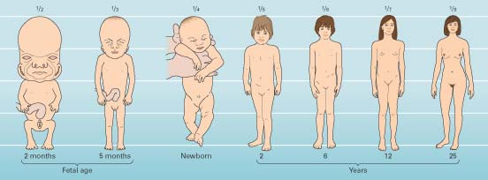
Language Development
Changes in Proportions of the Human Body During Growth
  Brain’s primary motor areas develop earlier than other areas.

Slide 27
Early sensory capacities
Touch and pain
Touch is the first sense to develop, and for the first several months it is the most mature sensory system.
By 32 weeks of gestation, all body parts are sensitive to touch, and this sensitivity increases during the first five days of life.

Slide 28
Smell and taste
The sense of smell and taste also begin to develop in the womb.
Taste preferences developed in infancy may last into early childhood.
Exposure to the flavors of healthy foods through breast-feeding (餵母乳) may improve acceptance of healthy foods after weaning (斷奶)and later in life.

Slide 29
Hearing
Hearing is functional before birth. Form an evolutionary (進化) perspective, early recognition of voices and language heard in the womb may start the foundation for the relationship with the mother, which is critical to early survival.

Slide 30
Sight
Vision is the least developed sense at birth, perhaps because there is so little to see in the womb.

Slide 31
Motor development
Head control
At birth, most infants can turn their heads from side while lying on their backs.
By 4 months, almost all babies can keep their heads erect (直立 / 豎起) while being held or supported in a sitting position

Slide 32
Hand control
At about 3.6 months, most infants can grasp an object of moterate (中等) size, such as a rattle (吹氣公仔), but have trouble holding a small object.
Next, they begin to grasp objects with one hand and transfer them to the other, and then to hold small objects.

Slide 33
Locomotion (移動)
After 3 months, the average infant begins to roll over deliberately (故意地) – first from front to back and then from back to front.
Between 6 – 10 months, most babies begin to get around under their own power by means of creeping or crawling (爬行).

Slide 34
Motor (運動神經)development and perception
Visual guidance means use of the eyes to guide the movement of the hands.
Depth perception refers to the ability to preceive objects and surfaces in three dimensions, depends on several kinds of cues that affect the image of an object on the retina (視網膜) of the eye.

Slide 35
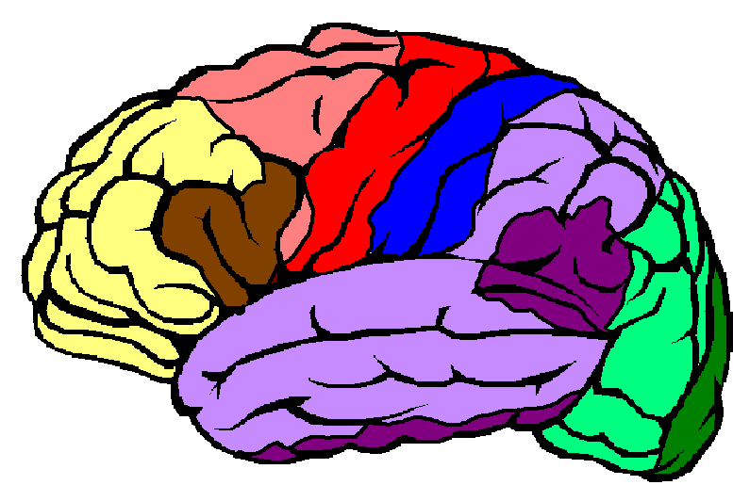
The Brain’s Hemispheres and Emotions
Motor cortex
腦皮層
Front
Concentrating, planning, problem solving
Language structure
Sensory cortex
Approach behaviors
Withdrawal撤退behaviors
Left
Right
Joy, happiness, pride自豪, anger, hostility, jealousy, interest, concern, responsibility
Distress 極度憂慮, misery 痛苦, agony 苦腦, disgust 氣憤, contempt鄙視, resentment 憤怒, fear, horror 震驚, anxiety
Primary hearing
Interpreting詮釋experiences
Primary visual
Language comprehension 理解

Slide 36
Enriched (富裕的) environments promote faster brain development than deprived ones.
Depressed brain activity has been found in children who grow up in a deprived(貧困的)environment.
After birth: sights, sounds, smells, touches, language, and eye contact help shape the brain’s neural (神經中樞的) connections.

Slide 37
Mother should not breast-feed if she has AIDS or other infectious diseases or active tuberculosis (結核病)or is taking drugs that can be transmitted through breast milk.
Prolonged and severe malnutrition can be detrimental to child’s cognitive, physical, and social development.
Toilet training should be a positive experience starting at around 2 years
of age or older.

Slide 38
Cognitive Development
Piaget proposed that
  Physical bodies can adapt to the world.
  Humans build mental structures to aid adaptation.
  Humans interactive with their environment.
  Children think differently at various points in their development.

Slide 39
Piaget’s 6 Substages of Sensorimotor Development
Substage | Age | Description
Simple reflexes | birth–1 month | Coordinates sensations, reflexes
First habits, primary circular reactions (循環反應) | 1–4 months | Coordination of sensations, habits, and primary circular reactions; body is still main focus of infant
Secondary circular reactions | 4–8 months | Infant becomes more object-oriented, repeats interesting/pleasurable acts
Coordination of secondary circular reactions | 8–12 months | Coordination of vision and touch, eye–hand coordination, intentional acts, coordination of schemes
Tertiary circular reactions, novelty (新奇), & curiosity | 12–18 months | Infants trickery by properties of, and things done with, objects; experiments with new behaviors
Internalization (內化) of schemes (分類) | 18–24 months | Infant develops ability to use primitive早期的symbols, forms lasting mental images

Slide 40
At the end of sensorimotor stage:
  Child achieves object permanence — the understanding that objects continue to exist even when they cannot be seen, heard, or touched.
  Infant understands a differentiation between self and world.
At around 5.5 and 6.5 months of age, an infant can understand simple causal factors .

Slide 41
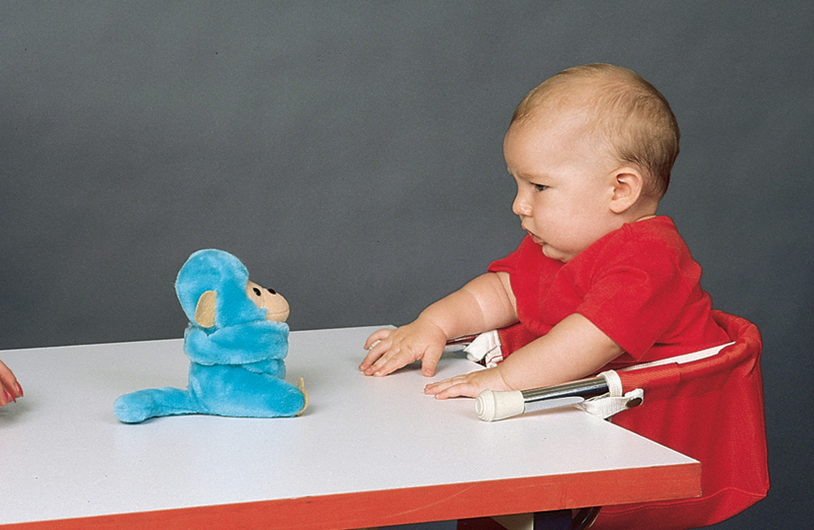
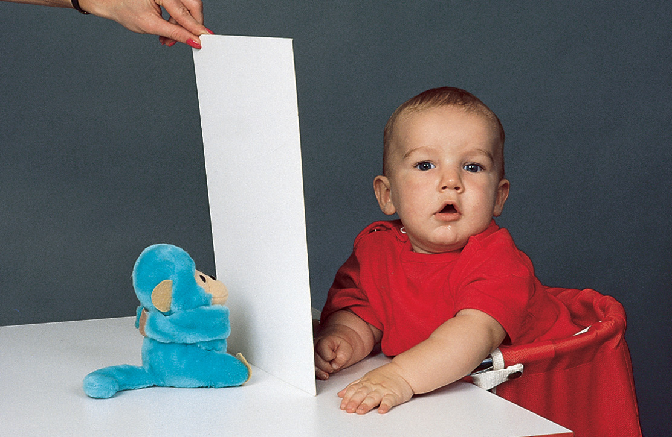
Object Permanence 持久（性）

Slide 42
Studying cognitive development – six approaches
The behaviorist approach studies the basic mechanics of learning, which fall in the domain of cognitive development. Behaviorists are concerned with how behavior changes in response to experience.
The psychometric (心理涮量) approach measures quantitiative differences in abilities that make up intelligence by using tests that indicate or predict these abilities

Slide 43
The Piagetian approach looks at changes, or stages, in the quality of cognitive functioning. It is concerned with how the min structures its activities and adapts to the environment.
The information-processing approach focuses on perception, learning, memory, and problem solving. It aims to discover how children process information from the time they encounter it until they use it

Slide 44
The cognitive neuroscience approach examines the hardware of the central nervous system. It seeks to identify what brain structures are involved in specific spects of cognition.
The social-contextual approach examines the effects of environmental aspects of the learning process, particularly the role of parents and other caregivers.

Slide 45
Language Development
There is evidence that
  Language has a biological basis.
  Everyone “knows” its rules and has ability to create infinite numbers of words and sentences.
Specific regions of the brain are predisposed to be used for language
  Broca’s Area (word production)
  Wernicke’s Area (word comprehension)
Damage to either of these areas produces types of aphasia (失語症), a loss or impairment of language processing.

Slide 46
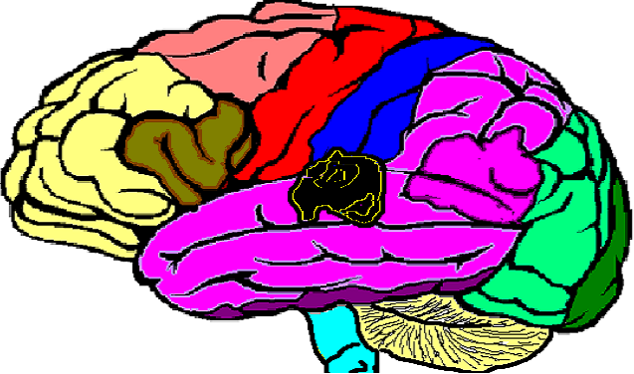
Broca’s Area and Wernicke’s Area
Broca’s Area
Wernicke’s Area

Slide 47
Behaviorists claim language is a complex learned skill acquired through responses and reinforcements.
Studies found link between size of child’s vocabulary and mother’s talkativeness愛說話.
Young children’s vocabularies are linked to family socioeconomic status.

Slide 48
Three strategies to enhance child’s acquisition of language other than child-directed speech
  Recasting (重組): rephrasing something the child has said
  Expanding state: repeating what the child has said but in correct structure
  Labeling: identifying the names of objects
Children vary (多變) in their ability to acquire language

Slide 49
Early vocalization (發聲)
Crying is a newborn’s only means of communication
Babbling (牙牙學語) repeating consonant (子音字母) such as “ma-ma-ma-ma”, occurs between ages 6 – 10 months.

Slide 50
Perceiving(感知-察覺)language sounds and structure
At first, infants can discriminate (區別) the sounds of any language.
By 6-7 months, hearing babies have learned to recognize the around 40 phonemes (音位及音素 eg. big / pig), or basic sounds, of their native (出生) language and to adjust to slight (微少)differences in the way different speakers form those sounds.

Slide 51
Gestures (手勢)
Before babies can speak, they point.
Early gestures are a good predictor of later vocabulary size.
Toddlers (剛走路的時候) often combine gestures with words. Gesture-word combinations serve as a signal that a child is about to begin using multi-word sentences

Slide 52
First words
The average baby says a first word sometimes between 10-14 months, initiating linguistic speech – verbal expression that conveys (傳達)meaning.

Slide 53
First sentences
The next important linguistic breakthrough comes when a toddler puts two words together to express one idea.
Generally, children do this between 18-24 months.

Slide 54
Influences early language development
Brain development
A brain imaging study points to the (emergence / appearance) of a link between the brain;s phonetic (語音)perception and motor systems as early as 6 months – a connection that strengthens by 6 to 12 months.
The development of language actively affects brain networks, committing them to the recognition of native language sounds only

Slide 55
Social interaction: The role of parents and caregivers
Children who grow up without normal social contact do not develop language normally.
Parents or other caregivers play an important role at each stage of language development. They do so (1) by providing opportunities for communicative experience, which motivate babies to learn language, and (2) by providing models of language use

Slide 56
Emotional and Personality Development
Temperament (性情)
Temperament
  Varying behaviors and moods among infants are usually due to differences in temperament.
  Temperament means characteristic disposition (性情) or style of approaching and reacting to situations
  Types of temperament:
    Chess and Thomas found 3 basic types: easy, difficult, and slow-to-warm child.
    Researchers have found that the 3 types (clusters) are moderately stable across the childhood years.

Slide 57
Three temperament patterns
“Easy” child | “Difficult” child | “Slow-to-warm-up” child
Has moods of mild to moderate intensity, usually positive | Display intense and frequently negative moods, cries often and loudly, also laughs loudly | Has mildly intense reactions, both positive and negative
Responds well to novelty and change | Responds poorly to novelty and change | Responds slowly to novetly and change
Quickly develops regular sleep and feeding schedules | Sleeps and eats irregularly | Sleeps and eats more regularly than the difficult child, less regularly than the easy child
Takes to new food easily | Accepts new foods slowly | Shows mildly negative initial response to new stimuli
Adapts easily to new situations | Is suspicious / mistrustful of strangers and Adapts slowly to new situations
Accepts most frustrations with little fuss / worry | Reacts to frustration with tantrums / bad temper
Adapts quickly to new routiness and rules of new games | Adjusts slowly to new routines | Gradually develops liking for new stimuli after repeated, unpressured exposures / experiences

Slide 58
  Kagan’s behavioral inhibition classifies child as shy, subdued (順從), timid
  (膽小), and sociable—extraverted (外向的).
Temperament may be influenced by:
  Parents who react differently to a boy or girl based on culture.
  Environment
  Genetics (遺傳學)

Slide 59
Foundations of psycho-social development
Approximate age, months | characteristics
0-3 | Infants are open to stimulation. They begin to show interest and curiosity and they smile readily at people
3-6 | Infants can anticipate what is about to happen and experience disappointment when it does not. They show this by becoming angry or acting carefully. They smile and laugh often. This is a time of social awakening (醒悟)and early reciprocal / mutual exchanges between the baby and the caregiver
6-9 | Infants play social games and try to get responses from people. They talk to , touch, and persuade other babies to get them to respond. They express more differentialed emotions, showing joy, fear, anger and surprise
9-12 | Infants are intensely preoccupied with their principle caregiver, may become afraid of strangers and act subdued in new situations. By 1 year, they communicate emotions more clearly, showing moods, ambivalence (矛盾心理 / doubt), and gradations of feeling
12-18 | Toddlers explore their environment, using the people they are most attached to as a secure base. As they master the environment, they become more confident and more eager /willing to assert themselves
18-36 | Toddlers sometimes become anxious because they now realize how much they are separating from their caregivers. They work out their awareness of their limitations in fantasy and I play and by identifting with adults

Slide 60
Developmental issues in infancy (嬰兒期)
Developing trust
Erikson’s eight stages in psycho-social development is basic trust verus basic mistrust.
This stage begins in infancy and continues until about 18 months.if trust predominates (主導), children develop the virtue(忠誠) of hope: the belief that they can fulfill their needs and obtain their desires.

Slide 61
If mistrust predominates, children will view the world as unfriendly and unpredictable and will have trouble forming relationships.

Slide 62
Developing attachments
(Still face experiment)
Attachement clasification | Behavior
Secure | Child plays and explores freely when her mother is nearby. She
Avoidance | When child mother returns, he doesn’t make eye contact or greet her. It is almost as if he has not noticed her return
Ambivalent (resistant) | Child hovers close to his mother during much of the strange situation, but he doesn’t greet her positively during the reunion episode. Instead, he is angry and upset
Disorganizd / disoriented | Child responds to the strange situation with inconsistent, contradictory behavior. He seems to fall apart, overwhelmed by the stress

Slide 63
Attachment
  Attachment is a close emotional bond (聯結) between two people.
  Theories of attachment:
    Freud: infants attached by oral satisfaction.
    Harlow: comfort preferred over food.
    Erikson: trust arises from physical comfort.
    Bowlby: newborn is biologically equipped to elicit attachment behavior from caregiver.

Slide 64
Strange Situation tests strength of infant attachment:
  Securely attached: explores environment, displays little emotion when caregiver leaves.
  Insecure avoidant: avoids caregiver but shows distress (憂慮) /crying when caregiver leaves.
  Insecure resistant: clings (纏著) to caregiver and protests loudly and actively if caregiver leaves.
  Insecure disorganized: disorientation (迷失方向); extreme fearfulness (害怕)may be shown even with caregiver.

Slide 65
Attachment between infant and caregiver:
  In 1st year of life, is foundation for later psychological development.
  Helps child to survive while incapable of self-care.
  Is not the only path to success because children are resilient and adaptive.
  Is affected by genetics and temperament.
  Varies among different cultures of the world.
  Should be secure if child is to develop fully.

Slide 66
The emerging(發展初期) sense of self
The self-concept is our image of ourselves – our total picture of our abilities and traits. It describes what we know and feel about ourselves and guides our actions. Children incorporate / integrate into their self-image the picture that others reflect back to them

Slide 67
Development of autonomy
Erikson identified the period from about 18 months to 3 years as the second stage in personality development, autonomy verus shame and doubt.
Having come through infancy with sense of basic trust in the world and an awakening (醒悟) self-awareness, toddlers begin to substitute their own judgment for their caregivers. The virtue that emerges during this stage is will (意志力及毅力).

Slide 68
The roots (基礎) of moral development
Socialization is the process by which children develop habits, skills, values, and motives that make them responsible, productive members of society.
Socialization rests on internalization of these standards. Children who are successfully socialized no longer obey rules or commands only to get rewards or avoid punishment; they have made society’s standards their own.

Slide 69
Developing self-regulation means control of her behavior to conform to a caregiver’s demands or expectations of her, even when the caregiver is not present.
Self-regulation is the foundation of socialization, and it links all domains of development – physical, cognitive, emotional and social.

Slide 70
Social Contexts
Social contexts in which infant emotional and personality development occur:
  Family:
    Adjustment of parents during infant’s 1st years.
    Infant care competes with parents’ other interests.
    Marital satisfaction and relationship may change.
    Reciprocal socialization: two-way interaction process.
    Scaffolding: parent supports child’s efforts.
    Family is a unit with assigned roles, shared attachments, and containing subsystems of relationships.

Slide 71
Fathers can be as competent as mothers in care-giving.
Maternal interactions center on child-care activities.
Paternal interactions tend to be play-centered.
In stressful situations, infants tend to prefer comfort from mother over that from father.
One study explored effects of parental roles in Sweden:
  Father was primary caregiver.
  Mother was full-time wage earner.

Slide 72
Quality of child care affected by:
  Group size, child–adult ratio, physical environment, caregiver characteristics.
  High-quality care results in child having better language and cognitive skills, being more cooperative and positive in interactions.
Quantity of child care affected by:
  More time in child care during first 3 years of life led to fewer positive interactions with mother.
  The more time spent in childcare, the higher the rates of illness.

